Slide 1
Visual Studio Code Installation

Slide 2
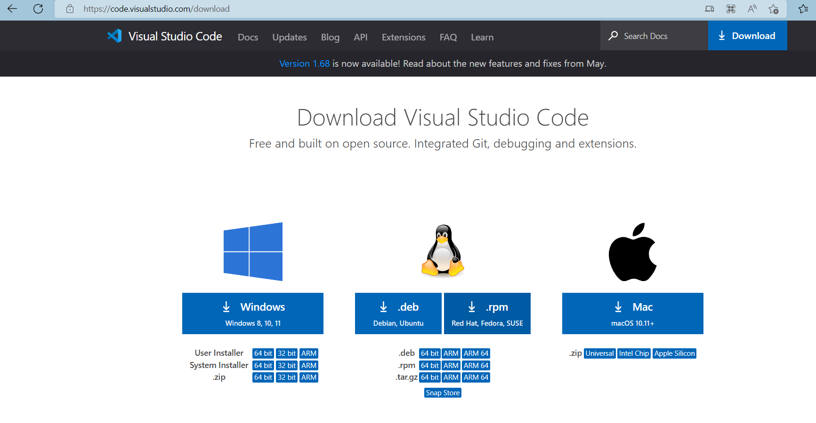
Click on below link to download VSCode and based on your OS click on system installer (64 bit)
Download Visual Studio Code - Mac, Linux, Windows

Slide 3
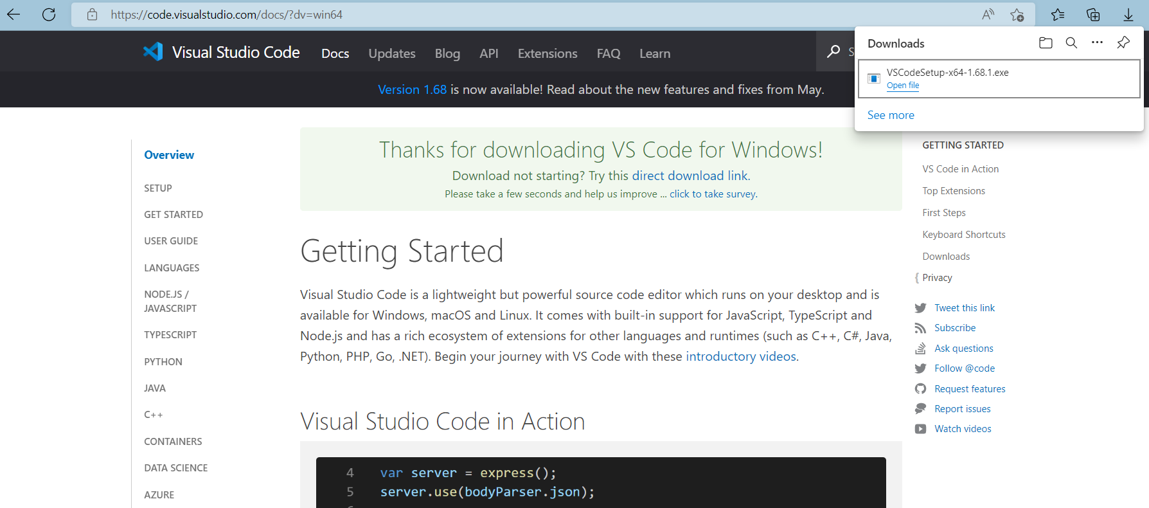

Slide 4
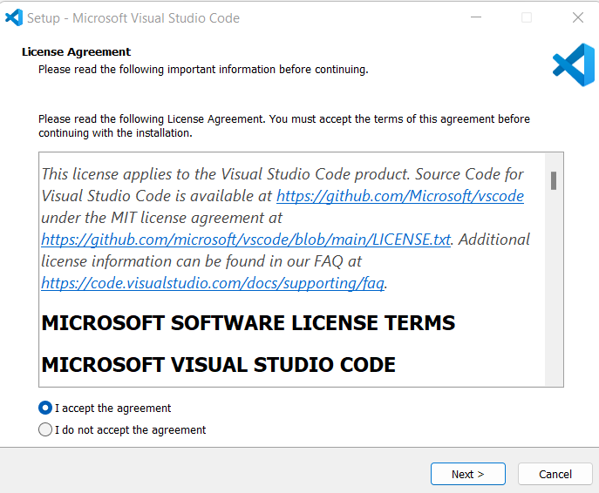
Click on downloaded VsCode set up file and it will pop up licence agreement and click “I Accept” and Next.

Slide 5
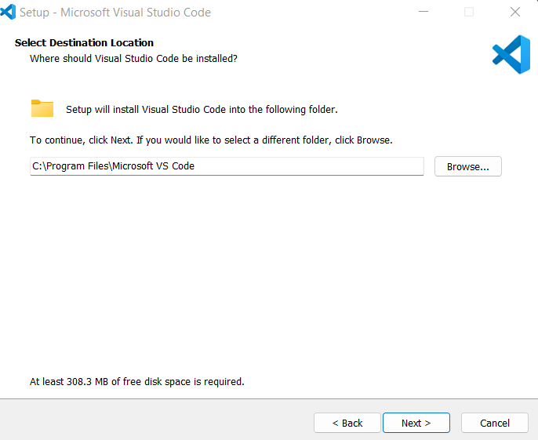
Click on Next

Slide 6
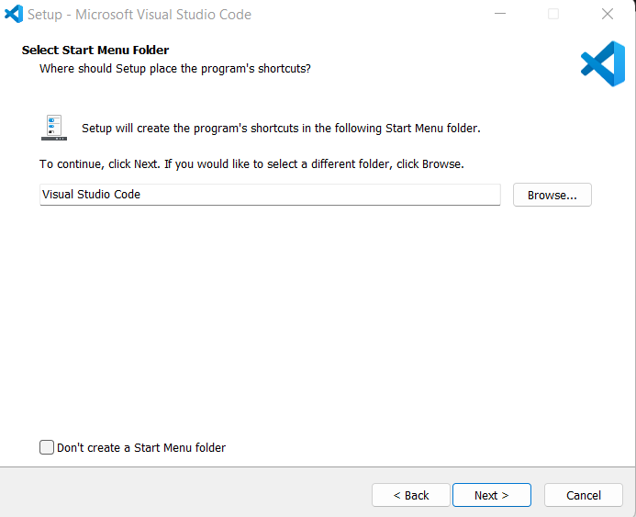
Click on Next

Slide 7
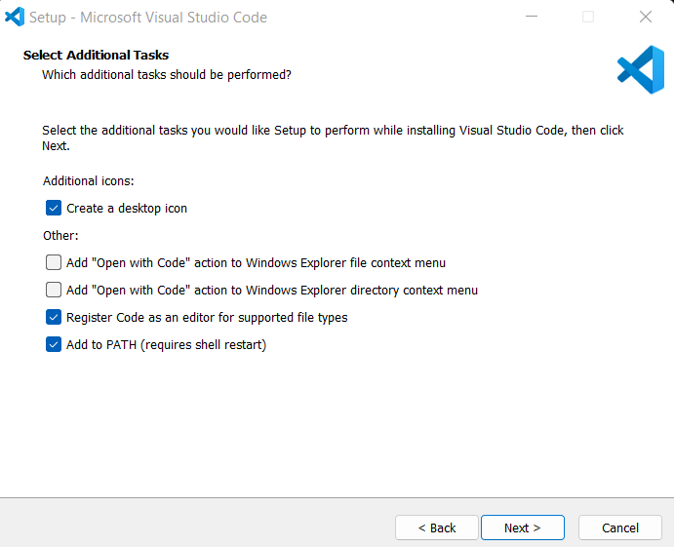
Click on Next

Slide 8
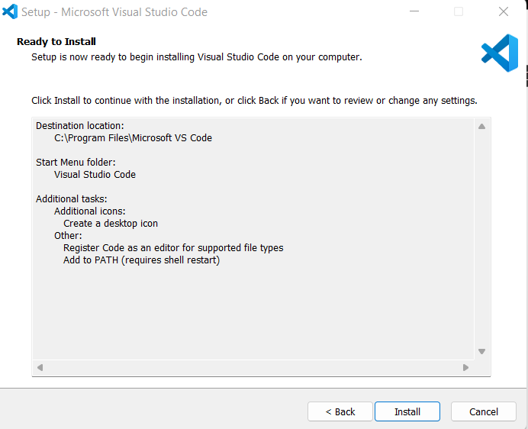
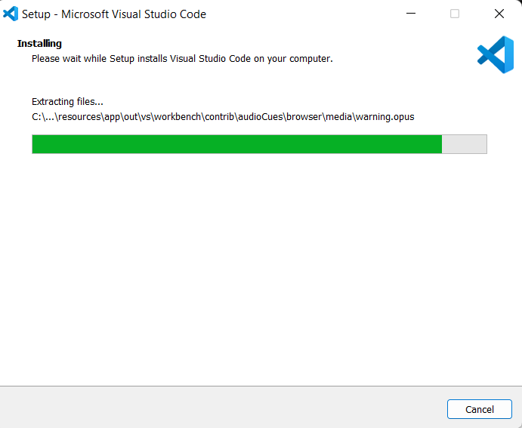
Click on Install

Slide 9
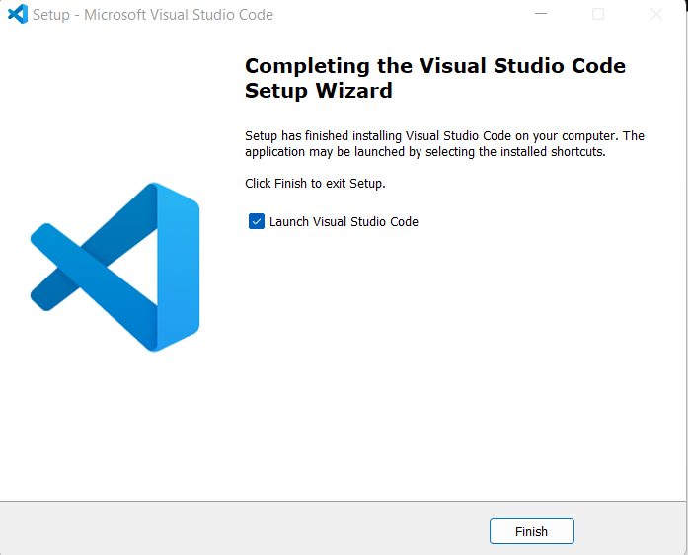
Click on Finish

Slide 10
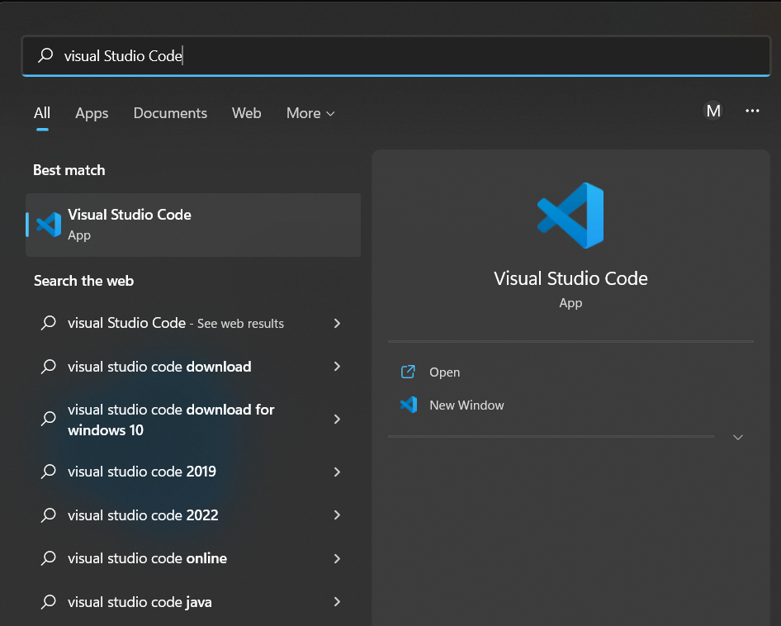
Go to windows search and type “Visual Studio Code” , click on Open.

Slide 11
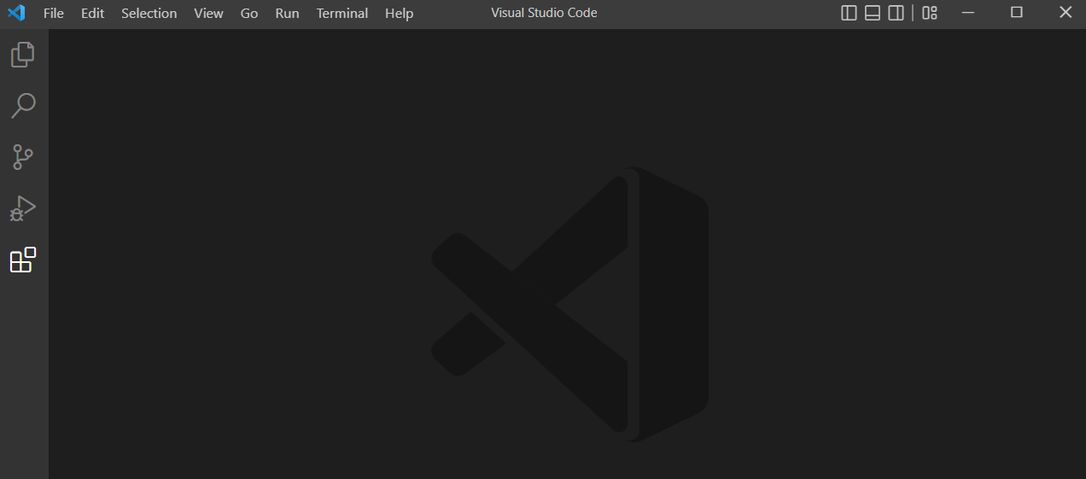
Open Visual Studio Code and Click on Extension

Slide 12
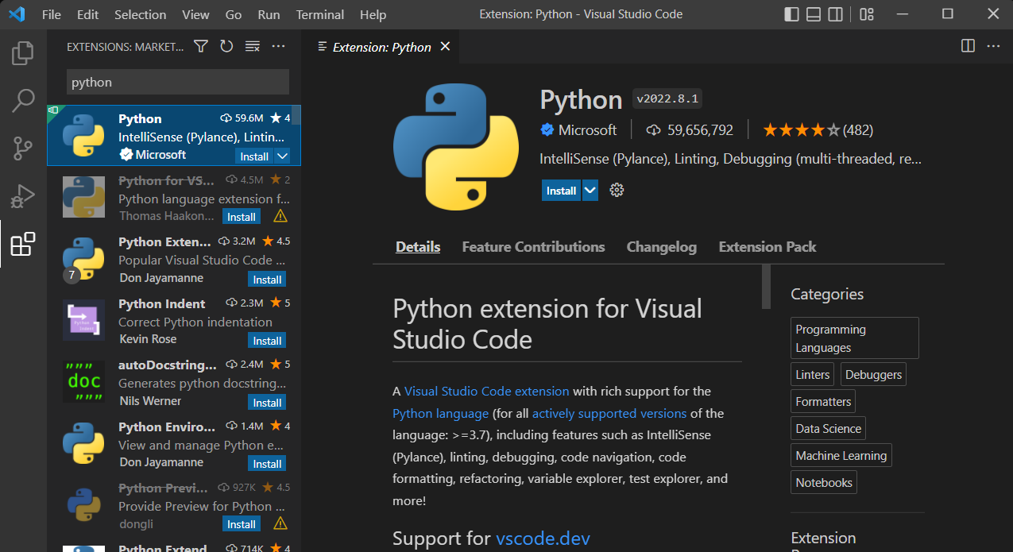
Type “Python” and click On “Install”.

Slide 13
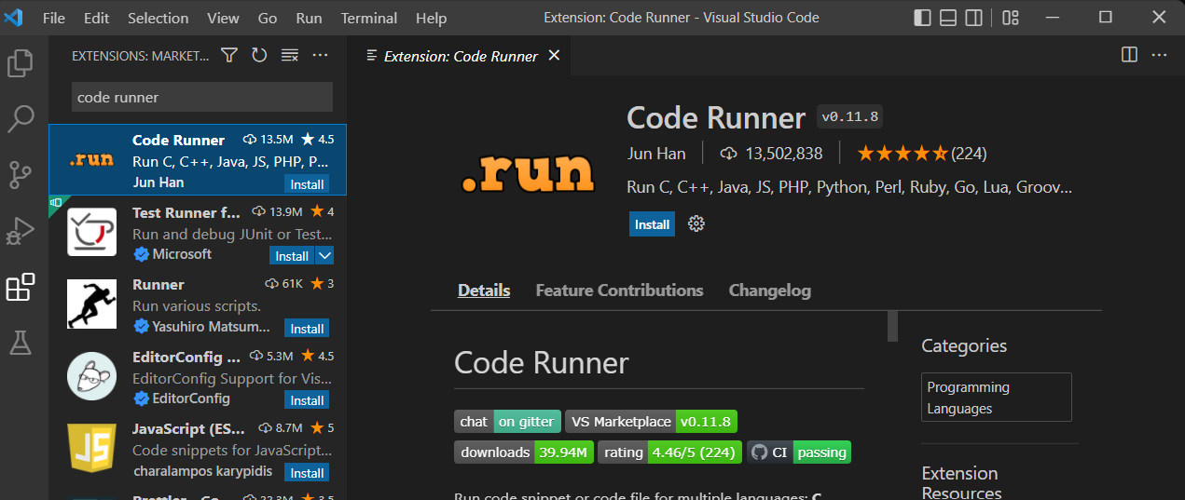
Type “Code Runner” and click On “Install”.

Slide 14
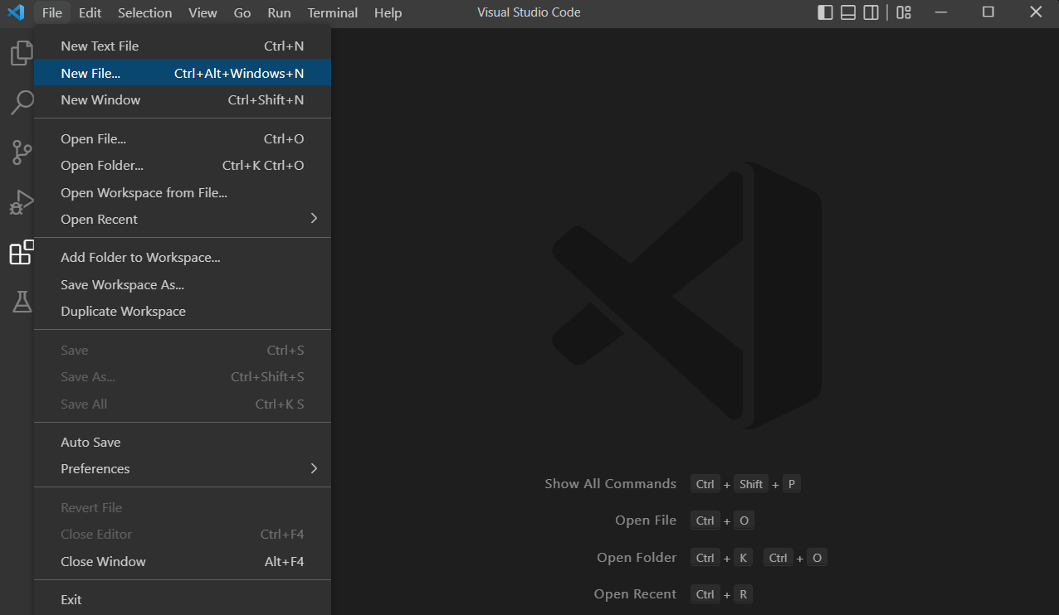
Go to File → click on New File.

Slide 15
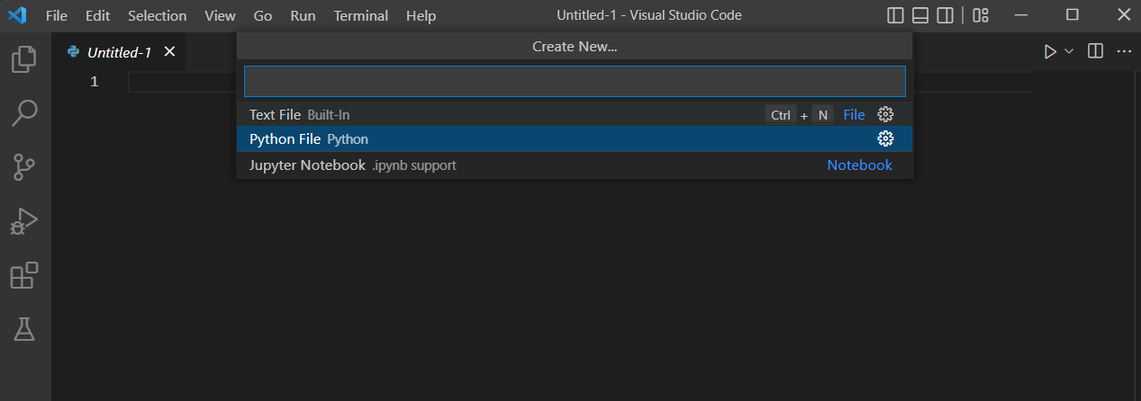
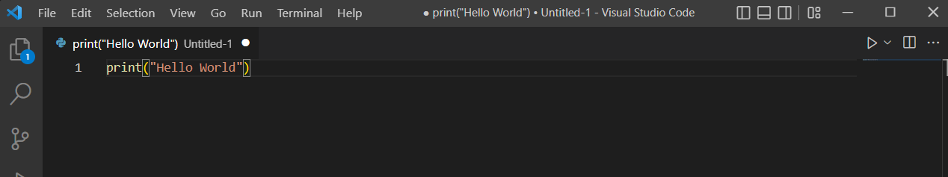
Select Python File type
Type → print(“Hello World”).

Slide 16
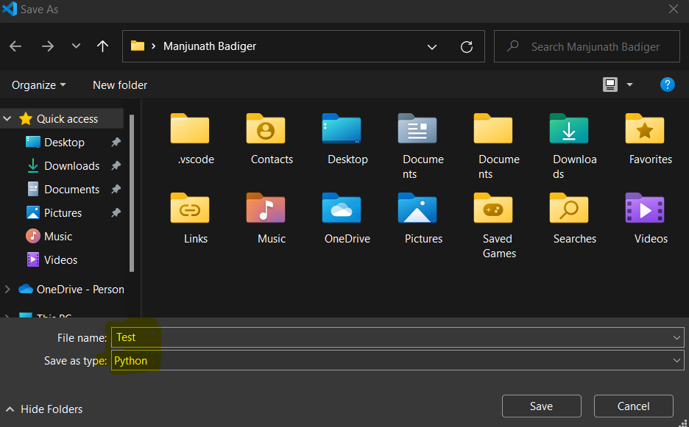
Save python file as shown below.

Slide 17
